Slide 1
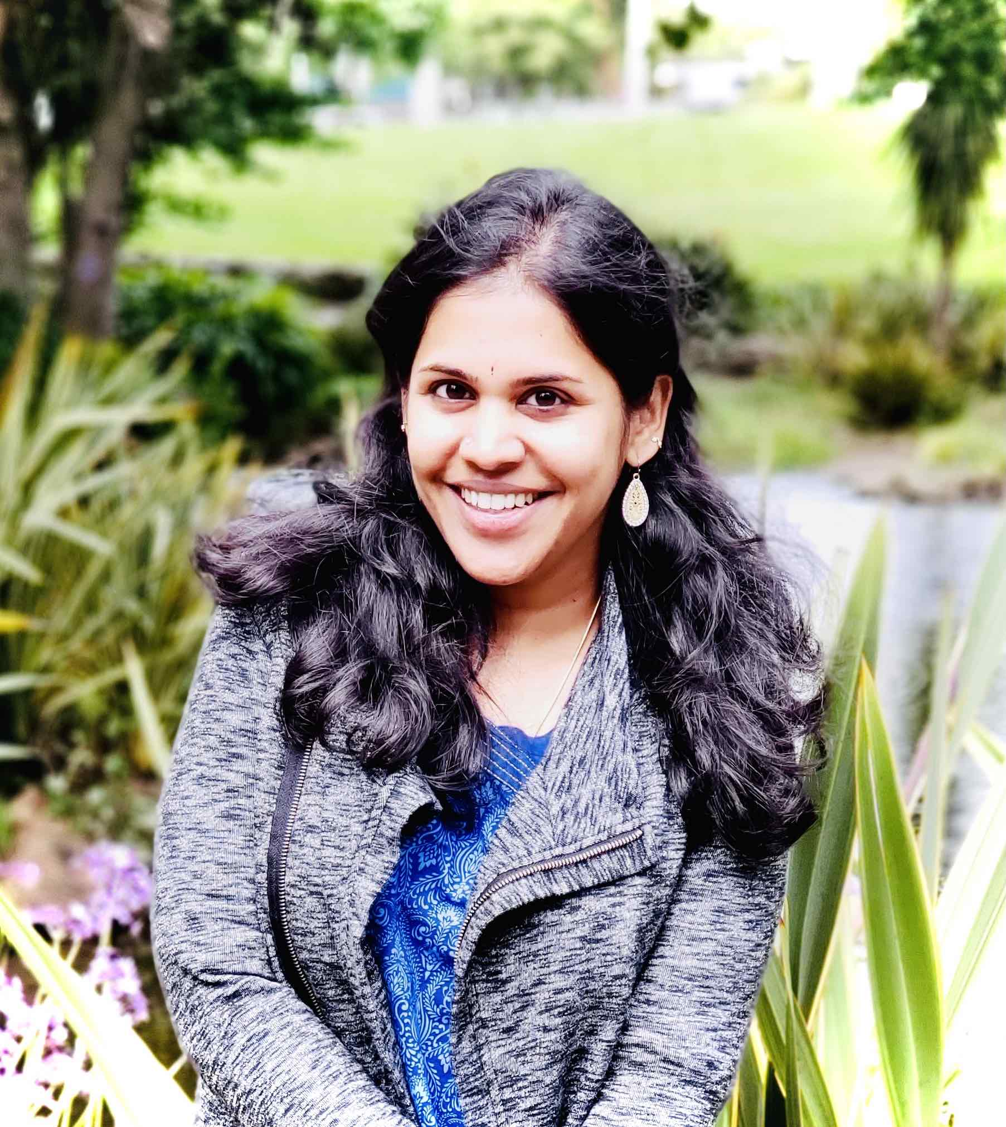
Hiranmayi Ranganathan
Machine Learning Researcher, Lawrence Livermore National Laboratory
My Experience
15+ years experience in Machine Learning, Computer vison, Deep learning applications
Developed many high-level theories/methods
Used machine learning for for health research
Worked in projects with DoE, NCI/NIH, & NIEHS
Education
MS, Electrical and Computer Engineering, UCSB
PhD, Deep Active Learning, Arizona State University
About Me
I grew up in Chennai, India, did my schooling and BS.
I like playing with my kids, singing and meeting friends.
I am a trained classical singer.

Slide 2
Seminar #5 by Dr. Hiranmayi Ranganathan
Date - Tue July 12, 2022, 1:00 pm – 2:00 pm ET
Meeting Link - https://teams.microsoft.com/l/meetup-join/19%3ameeting_MjQ5YjgxNGEtYjEwNC00ZGQ4LThlZDYtYWM1ZTA4NmYzZjlm%40thread.v2/0?context=%7b%22Tid%22%3a%2214b77578-9773-42d5-8507-251ca2dc2b06%22%2c%22Oid%22%3a%222e31b4fb-2c54-4995-be48-173a24bc5b84%22%7d
TITLE – Basic Introduction to Machine Learning
PRESENTER – Dr. Hiranmayi Ranganathan, Ph.D. Machine Learning Researcher, LLNL
ABSTRACT - In this seminar, we will learn what is machine learning, main branches of machine learning, the ML workflow: Data Collection, Feature engineering, training, validation, testing , evaluation and hyper parameter tuning. We will also see how ML is applied in computational Drug Discovery.

